Slide 1

Analysis on GSM Arena Dataset
Presenter: Monish Bangera

Slide 2
Problem Statement Statement
Every business needs to research its competitor before launching a new cell phone.
With increasing competition, it is becoming difficult to attract customers. Hence, a company needs to determine who are its competitors, analyze which brand has the highest and lowest mean price , what kind of products they are selling, also analyze what are the factors that makes a product successful. E.g., check which type of CPU has the highest or lowest mean price.
After analyzing all these factors, the company can produce a strategy to design its product with most popular features.
Based on these factors decide the price for the product so that it can attract more customers.

Slide 3
Data ExtractionExtraction
I scraped the mobile pricing data from a website called GSMARENA.
GSMARENA is a website that has the pricing data and reviews of mobile phones of various brands.
I used python package named Selenium to perform the data scraping task.

Slide 4
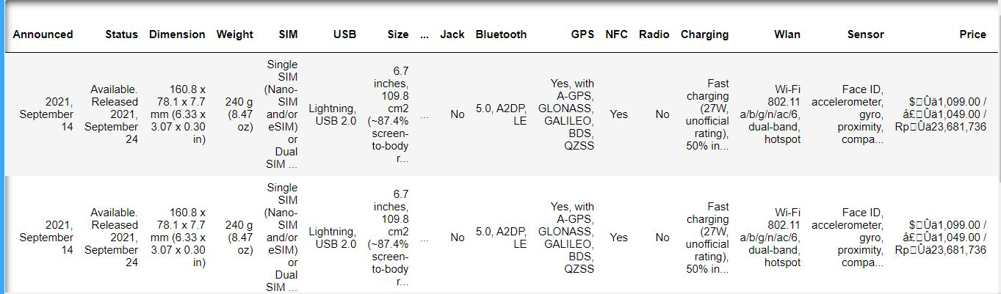
Data Preprocessing
We can see that the data is very noisy and needs to be cleaned.
The Price column has various unwanted texts and the price is in different currencies. We need to convert it to USD. Also, other columns need to be cleaned.

Slide 5
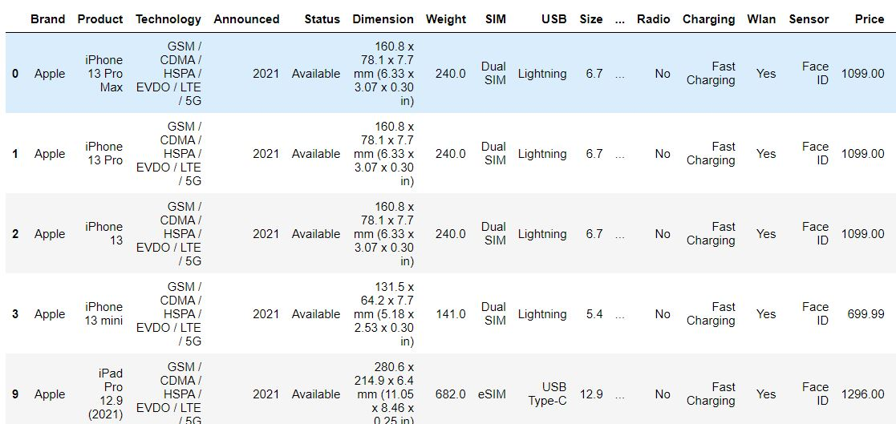
Data Preprocessing
In the image below we can see the dataset after performing various preprocessing tasks.
The price is converted to USD, also other unwanted texts from various features are removed.

Slide 6
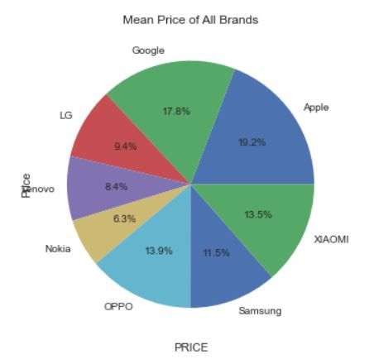
Data Visualization
The graph shows the pie chart of average price of various cell phone brands.
Apple has the highest mean price and Nokia has the lowest mean price.

Slide 7
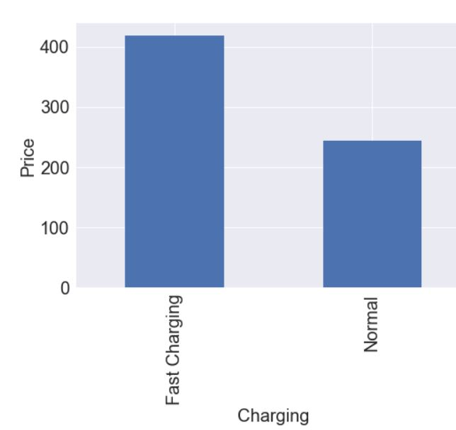
Charging VS Price
This graph shows the relationship between Charging type and price.
The Fast Charging feature has a very high mean price as compared to Normal charging.

Slide 8
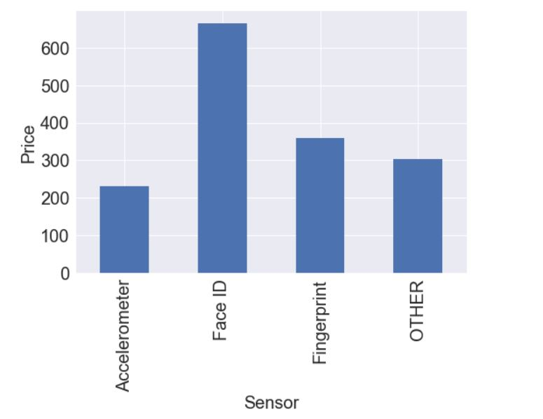
Sensor VS Price
This graph shows the relationship between Sensor and Price.
We can see that Face ID sensor has the highest mean price and Accelerometer has the lowest.

Slide 9
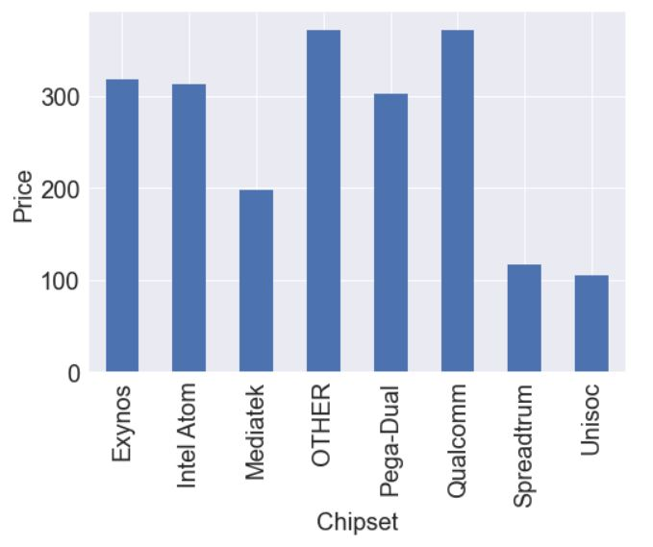
Chipset VS Price
The graph shows the relationship between Chipset and Price.
We can see that Qualcomm has the highest average price and Unisoc has the lowest.

Slide 10
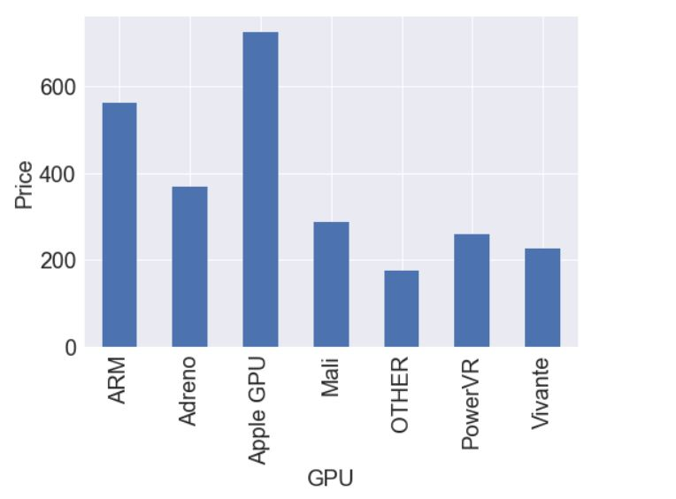
GPU VS Price
This figure shows the relationship between GPU and Price.
Apple GPU has the highest mean price and Vivante has the lowest mean price.

Slide 11
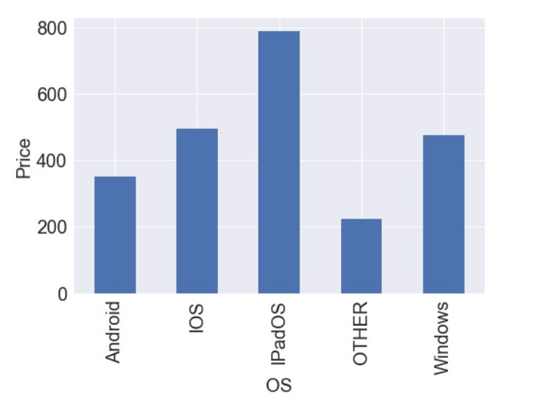
OS VS Price
This graph shows the relationship between OS and Price.
IPad OS has the highest average price.
Android and Other OS has lower average price as compared to other operating systems.

Slide 12
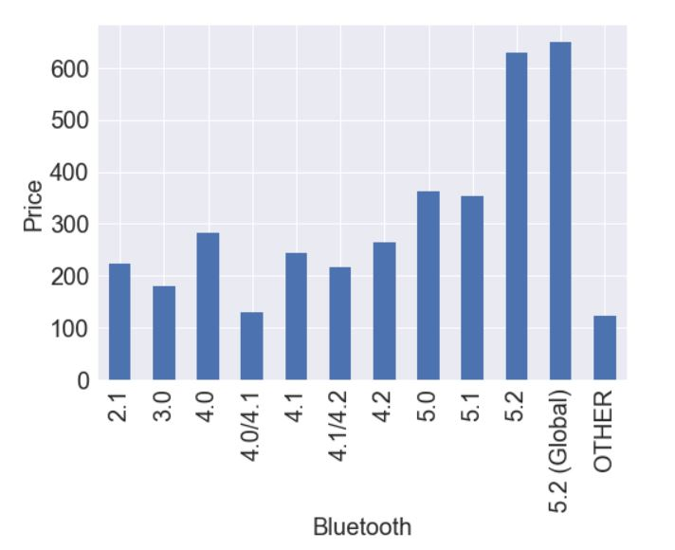
Bluetooth VS Price
This figure shows the relationship between Bluetooth and Price.
We can see that Bluetooth version 5.2 (Global) has the highest mean price.
Bluetooth version 4.0/4.1 and other versions has lower mean price.

Slide 13
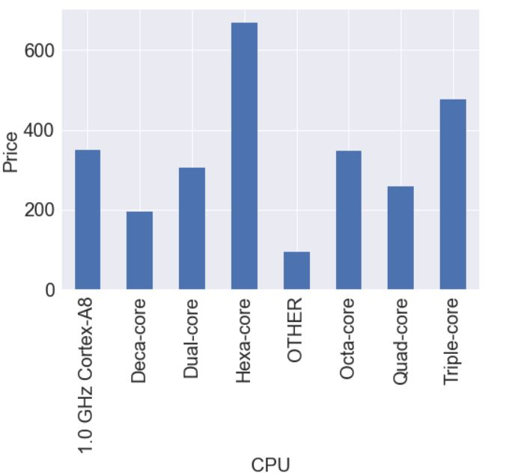
CPU VS Price
This figure shows the relationship between CPU and Price.
Hexa-core CPU has the highest average price.
Deca-core and other CPU's have lower average price.

Slide 14
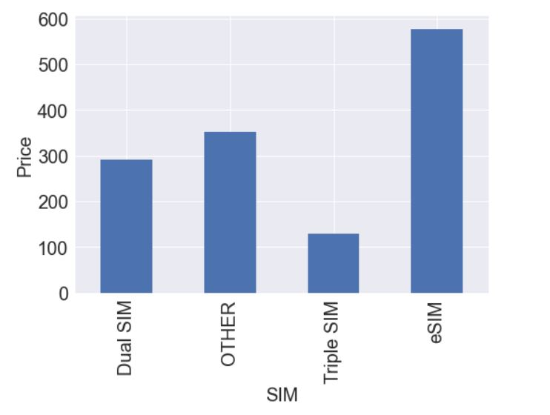
SIM VS Price
This figure shows the relationship between the type of SIM and Price of cell phone.
Cell phones with Esim has the highest mean price and Triple sim has lowest mean price.

Slide 15
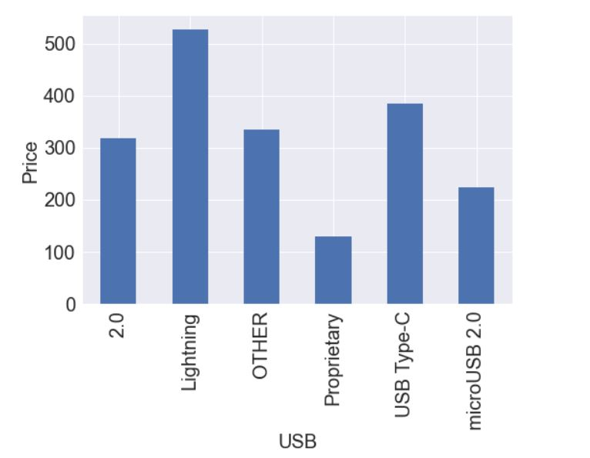
USB VS Price
This figure shows the relationship between Price and type of USB they have.
Lightning USB has the highest mean price and Proprietary has the lowest.

Slide 16
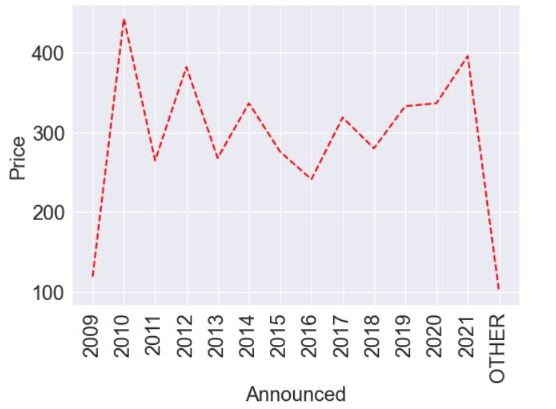
Announced Year VS Price
This graph shows the relationship between Announced Year and Price.
The cell phones announced in the year 2010 have highest mean price.
The cell phone announced in 2016 have lowest mean price.

Slide 17
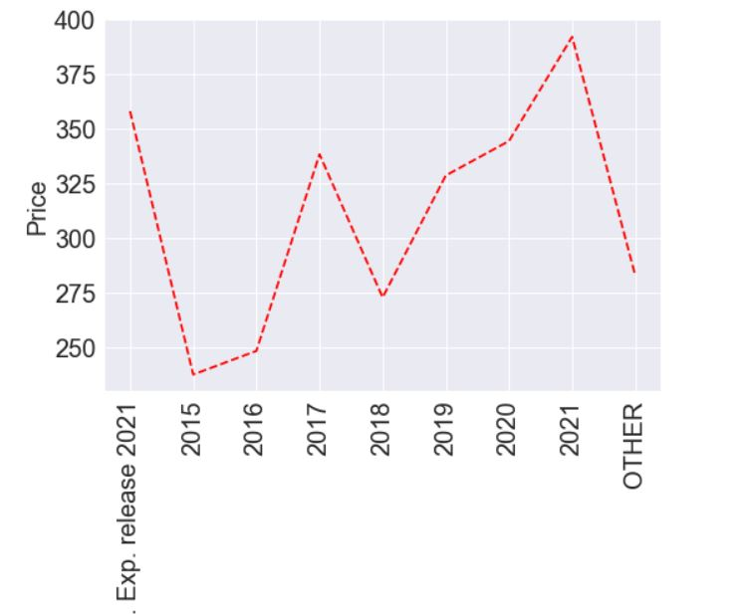
Released Year VS Price
This line graph shows the relationship between Release Year and Price.
We can see that the mobile phones released in 2021 have highest mean price.
Cell phones released in 2015 has lowest mean price.

Slide 18
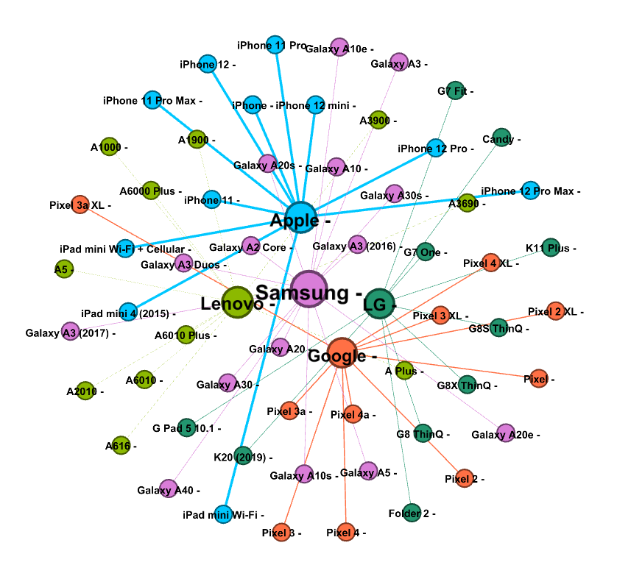
Social Network Graph of Brands
This social network graph shows the relation between brands and its products.
Brands and products are the nodes, and the mean price is the edges connecting them.
We can clearly see that Apple has the biggest node size and edge thickness that’s because it has the highest mean price.

Slide 19
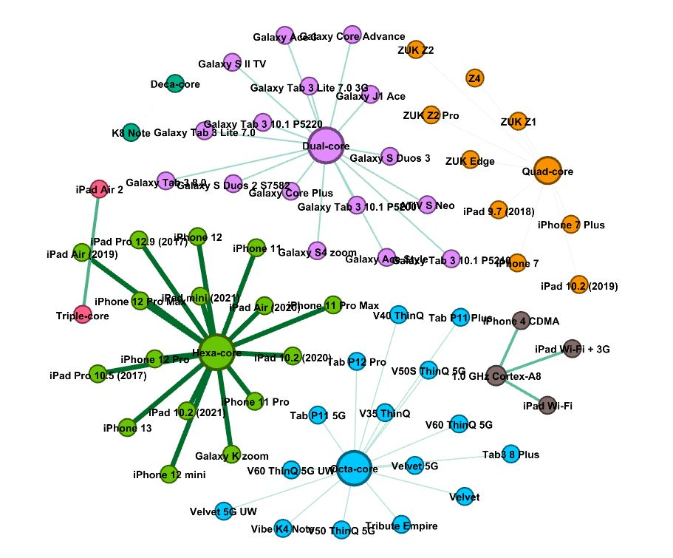
Social Network Graph of CPU
This network graph shows the relationship between mobile phones and its CPU.
The nodes in this case are mobile phones, type of CPU and edges are mean price which connects them.
In this case we can clearly see that Hexa-core has the highest mean price because of the size of node and the outgoing edges.

Slide 20
Conclusion
After looking at this analysis we can get insights such has which type of CPU, chipset, OS etc. has highest mean price.
Whenever a brand is looking to launch a new product in the market, they can design their product based on these insights. For example, cell phone with highest mean price have ESIM as their sim type so while designing the cell phone company can include this feature so that it can attract more customers.
Also, the social network graph helps us visualize various brands of cell phones based on their mean price. And each brand is connected to its products.
This will help business owners to understand which product belongs to which brand.

Slide 21
THANKYOU

